Slide 1

Welcome to the
2023
December 2, 2023
SCHEDULE: https://www.granitestatecodecamp.org/venue

Slide 2


Thank you to our host venue!

Slide 3

Thank you to our 2023 Sponsors!
Gold Sponsor

Slide 4



Thank you to our 2023 Sponsors!
Silver Sponsor
Silver Sponsor
Bronze Sponsor

Slide 5








Thank you to our supporting organizations!
This event was also made manageable by these organizations in support of free, grass-roots events like Granite State Code Camp 2023
Volunteer Event Management

Slide 6
Post-event awards!
Don’t miss the post-event
Capture the Flag awards!
Prizes include
gift cards to online merchants
such as our
Digital Trading Post!

Slide 7
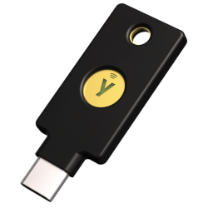
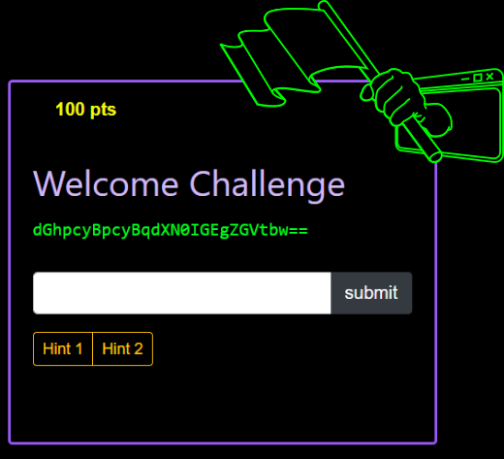
CAPTURE the FLAG
All Participants entered to win a Yubi Key!
A Fun Hacking Challenge Open now!
Solutions to be revealed later TODAY! $100(1) & $50(3) trading post gift cards to top contestants!
https://ctf-2023.azurewebsites.net

Slide 8








HANG OUT IN THE...
CODE CAMP LODGE
Take a break
between sessions
Chat with other campers
and meet new people!
Learn more about
other Granite State
events...
DIGITAL
TRADING POST

Slide 9
Remote attendee etiquette 2
Remote attendees, please use the “raise hand” feature
and wait for the scheduled presenter to acknowledge you
before activating your microphone (and camera)
to ask questions.

Slide 10
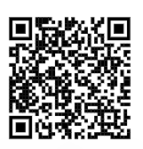
Session Feedback Forms
Please provide feedback about sessions you attend

Slide 11
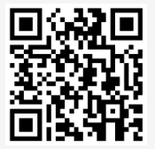
Event Feedback Forms
Please tell us how you liked Granite State Code Camp 2023

Slide 12
Remote attendee etiquette
Remote attendees, please deactivate your camera and remain on mute in scheduled presentations.
(A professional networking meeting runs all day in Teams for informal video conversation.)

Slide 13
Code of Conduct
Please remember professional courtesy, and the Code of Conduct at all times…
(…but especially please try to
conflate others’ enjoyment
of the event with your own.)

Slide 14
Thank you
Thank you
for including yourself
and contributing to
the Granite State coder community

Slide 15


Introduction to Accessibility
Erissa Duvall – Granite State Code Camp 2023

Slide 16
Disclaimer
While I may mention some examples from current/past jobs, I am not representing any of my employers during this presentation.
Additionally, while I will discuss some legislation, I am not a lawyer and nothing I say should be taken as definitive legal advice.

Slide 17
Overview
What is Accessibility?
Models of Disability
Disability Impacts
Accessibility Guidelines
Accessibility Regulations
Why?
What can we do?

Slide 18
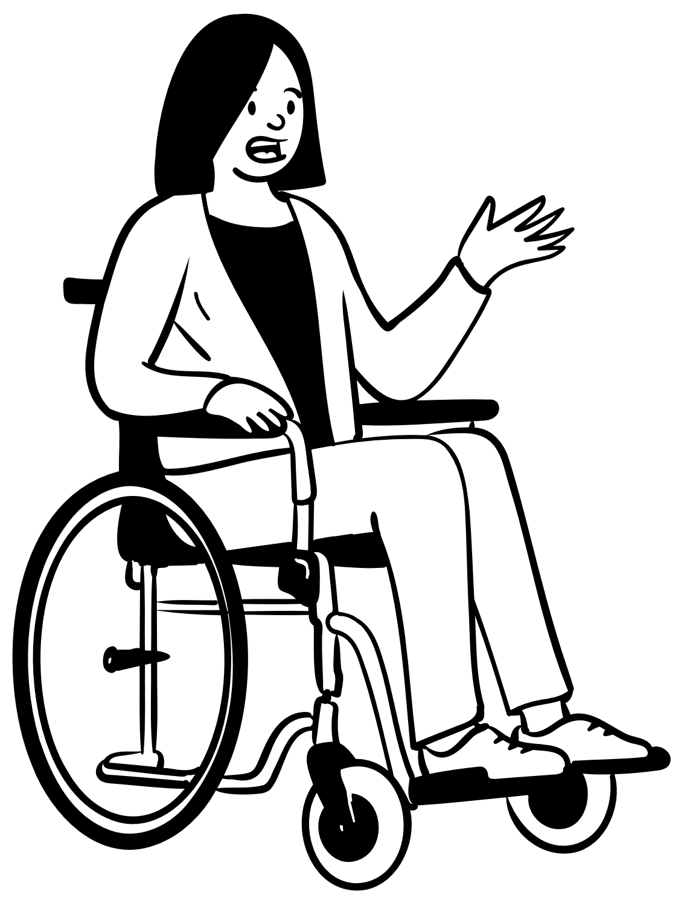
What is Accessibility?
Notes:
Accessibility – how well can your product be used by people of all abilities?
Disability – A disability is basically a mismatch in interaction between a person’s body and the features of their environment in which they live.
Adaptive/Assistive Technology (AT) - is any item, piece of equipment, software program, or product that is used to increase, maintain, or improve the functional capabilities of people with disabilities.
A11y – a commonly accepted numeronym for Accessibility that stands for the fact that Accessibility starts with an “A”, ends with a “Y” and has 11 characters in between.

Slide 19


Models of Disability
Medical Model
Social Model
Notes:
Jeremy Andrew Davis has awesome videos describing the differences between the Social and Medical models:
Jeremy Andrew Davis on Instagram: https://www.instagram.com/jeremyandrewdavis/

Slide 20
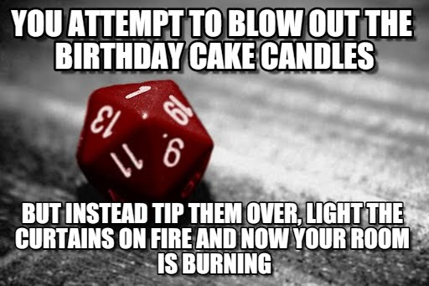
Disability Impacts
Notes:
Disabilities can affect people in different ways:
What part of their life does it affect?
Ability to eat
Ability to breathe
Ability to walk, stand, or lift
Ability to interpret information
Ability to see or hear
Ability to care for themselves
Visibility of the disability
When does it affect them? (temporary, permanent, situational)

Slide 21
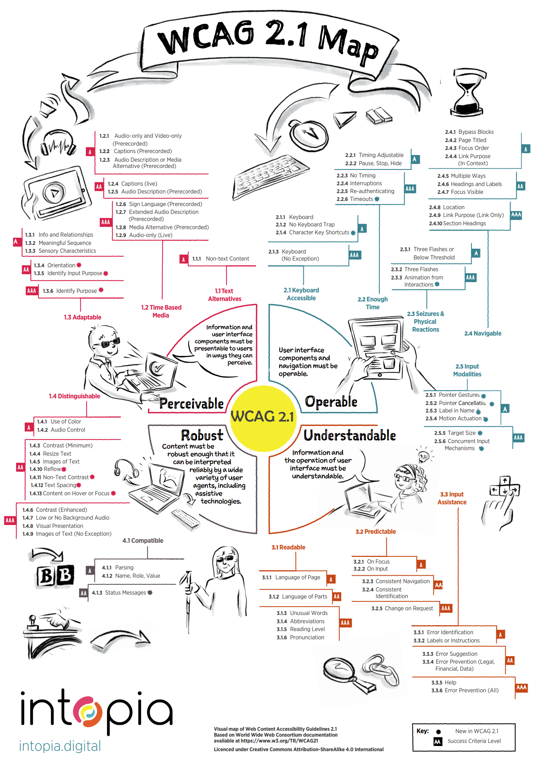
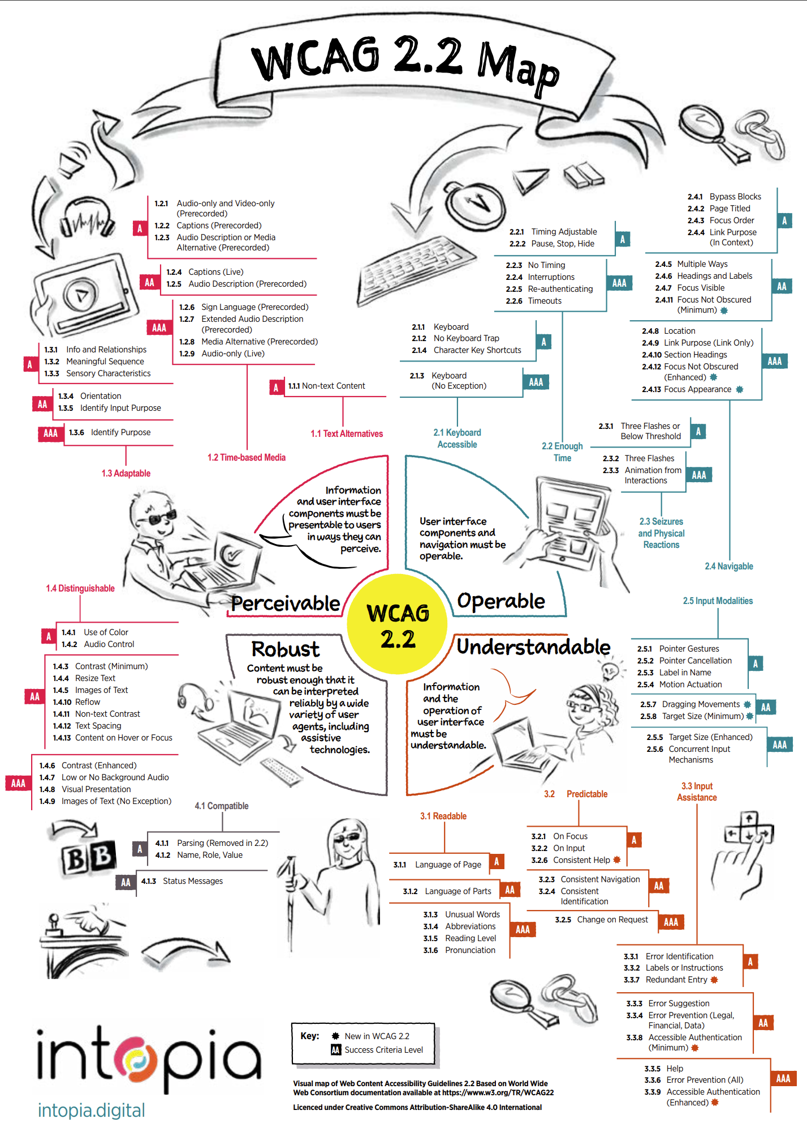
Accessibility Guidelines
Notes:
Intopia’s WCAG 2.2 Map can be found at the following URL: https://intopia.digital/articles/intopia-launches-wcag-2-2-map/
Intopia’s WCAG 2.1 Map can be found at the following URL: https://intopia.digital/articles/intopia-launches-wcag-2-1-map/
Alternatively, you can view the WCAG 2.2 Guidelines at the following W3C URL: https://www.w3.org/TR/WCAG22/
“Note that even content that conforms at the highest level (AAA) will not be accessible to individuals with all types, degrees, or combinations of disability, particularly in the cognitive, language, and learning areas.” - WCAG 2 Layers of Guidance
WCAG is broken down into:
4 Principles (POUR)
Perceivable
Operable
Understandable
Robust
Those 4 principles are then divided up into 13 Guidelines, which are then further split up by a total of 86 Success Criteria.
Those Success Criteria are then split up across 3 levels of Conformance (A, AA, AAA)

Slide 22

Accessibility Regulations
Learn more at: Web Accessibility Laws & Policies | WAI | W3C
Notes:
Americans with Disabilities Act (ADA)
Section 508 of the Rehabilitation Act of 1973
Section 255 of the Communications Act

Slide 23




Why?
Notes:
Accessibility helps to:
Remove barriers
Allow equal access
Through that we create an environment that:
Feels more welcoming / inclusive
Encourages diversity
Helps people make informed decisions
Encouraging innovation / productivity / progress
A Hidden Market: The Purchasing Power of Working-Age Adults With Disabilities | American Institutes for Research (air.org)
Article URL: https://www.air.org/resource/report/hidden-market-purchasing-power-working-age-adults-disabilities
`The total disposable income for U.S. adults with disabilities is about $490 billion, which is comparable to other significant market segments, such as African Americans ($501 billion) and Hispanics ($582 billion). (Disposable income is what is left after taxes are paid.); and Discretionary income for working-age people with disabilities is about $21 billion, which is greater than that of the African-American ($3 billion) and Hispanic ($16 billion) market segments, combined. (Discretionary income is the money remaining after deducting taxes, other mandatory charges, and spending on necessities, such as food and housing.”

Slide 24

What can we do?
Notes:
Shift left
Speaking up / being an ally
Nothing without us
Respectful, people-first language
Follow best practices and guidelines
Involve a variety of expertise, utilities, departments, etc.

Slide 25
Resources
Microsoft Accessibility on Twitter at @MSFTEnable and at on the Microsoft Accessibility page.
Microsoft Accessibility Fundamentals course
ANDI – Bookmarklet developed by the Social Security Administration to aid in accessibility testing.
VGAR – Visa Global Accessibility Requirements
Section 508 ICT Testing Baseline for Web - This Baseline identifies the minimum requirements of any test process used to determine conformance of web content with the Revised Section 508 of the Rehabilitation Act of 1973, as amended (29 U.S.C. 794d).
Trusted Tester: Section 508 Conformance Test Process for Web – A standardized approach for manual inspection of web content for conformance with the revised Section 508 Standards.
IT Accessibility Laws and Policies | Policy & Management | Section508.gov – A page maintained by the GSA that provides information on some Accessibility related laws and policies
Web Accessibility Laws & Policies | WAI | W3C – Lists some United States governmental policies, regulations, and standards related to web accessibility.

Slide 26
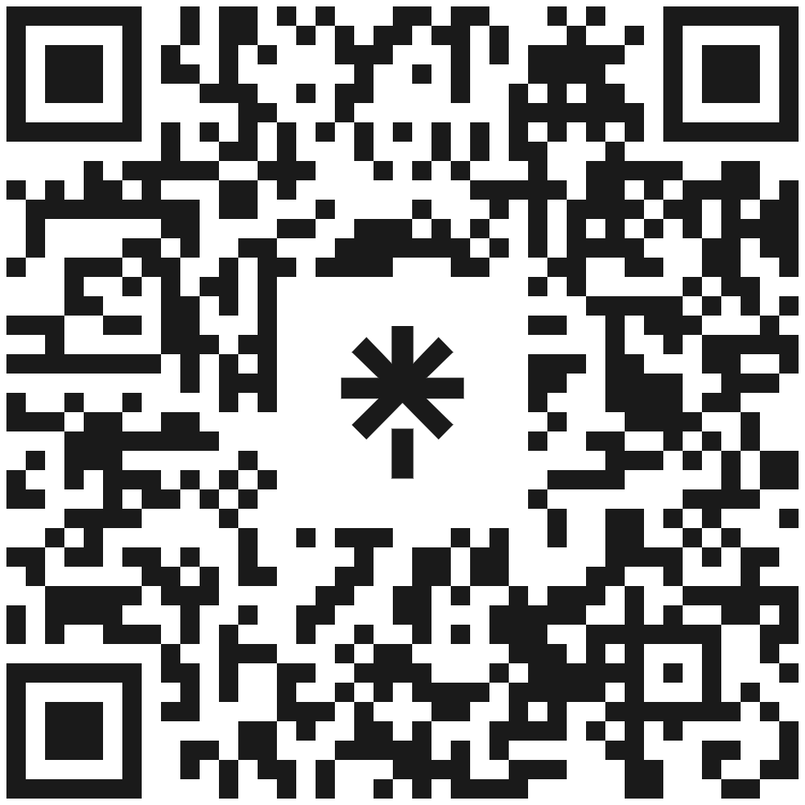
Thank You!
Questions?
linktr.ee/corgidev

